Slide 1
Predicting Income of above or below 50k
Using US Census Archive Data
Alexander D’Cruz

Slide 2
The data
Survey data from US population collected over 2 years
Initial (brief) analysis was carried out on the data and the key findings were:
Various features are highly skewed - weeks worked, dividends, capital gains etc
Very imbalanced target variable - 93.8% surveyed earn less than 50k, only 6.2% earn above
Missing data for some features
Large amount of categorical data with some encoded categorical features

Slide 3
Pre-processing Methods
Feature selection - removed features with high % of missing values
Feature engineering
Certain numerical features were changed to categorical (‘Num persons worked for employer’ for example was a multiple choice question so the numerical values while ordinal don’t scale to linearly
Weeks worked in a year was binned, this could have been min max scaled but I wanted to see what impact this would have. This was a highly skewed feature and I thought binning it might return promising results.
Further feature engineering recommended - cross features perhaps.
Scaling
Numerical features were standardised

Slide 4
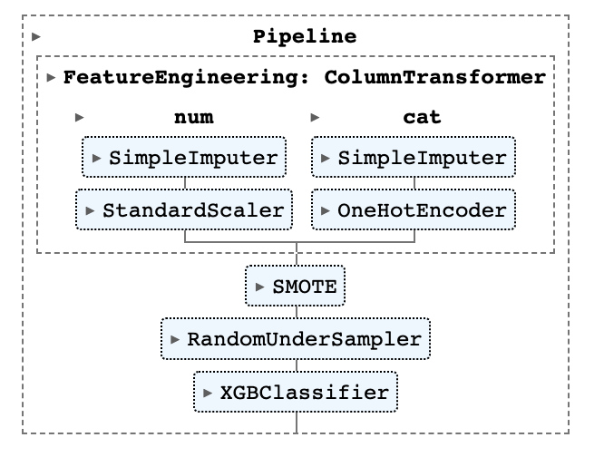
Modelling approach
With a focus on repeatability I began building the start of a pipeline of functions to pass the data through.
The pipeline imputes missing numerical values with the median and scales them.
It imputes missing categorical values with the most frequent value and then encodes these features into something machine readable.
Then it balances the data before fitting an XGBoost Classification algorithm.

Slide 5
Baseline Model
How do we know our models are any good?
We begin with a baseline and understanding our prediction metrics
The ‘accuracy’ of always predicting the majority class (<50k) would be 94%... but then we would never predict anyone as earning over 50k.
Assuming we care about the >50k earners we’ll use F1 score as a metric.
Calculating the baseline for our model can be done a couple of ways.
Predicting both with equal probability
F1: 0.11
Predicting the majority
F1: 0.0
Predicting the class we’re interested in
F1: 0.12

Slide 6
Comparing Models
Four models were compared for this analysis
Their performance was as follows
Logistic Regression, F1: 0.496
Support Vector Machine, F1: 0.534
Decision Tree, F1: 0.457
XGBoost, F1: 0.610

Slide 7
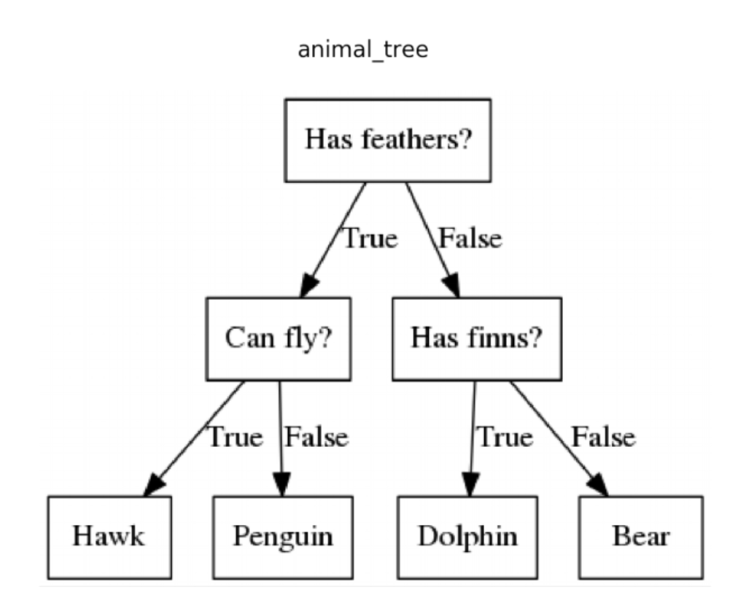
What is XGBoost?
XGBoost is a Gradient Boosted Decision Tree
A simple example of a decision Decision Tree can be seen here.
Gradient Boosting is when we fit sequential trees which minimise the errors of previous models

Slide 8
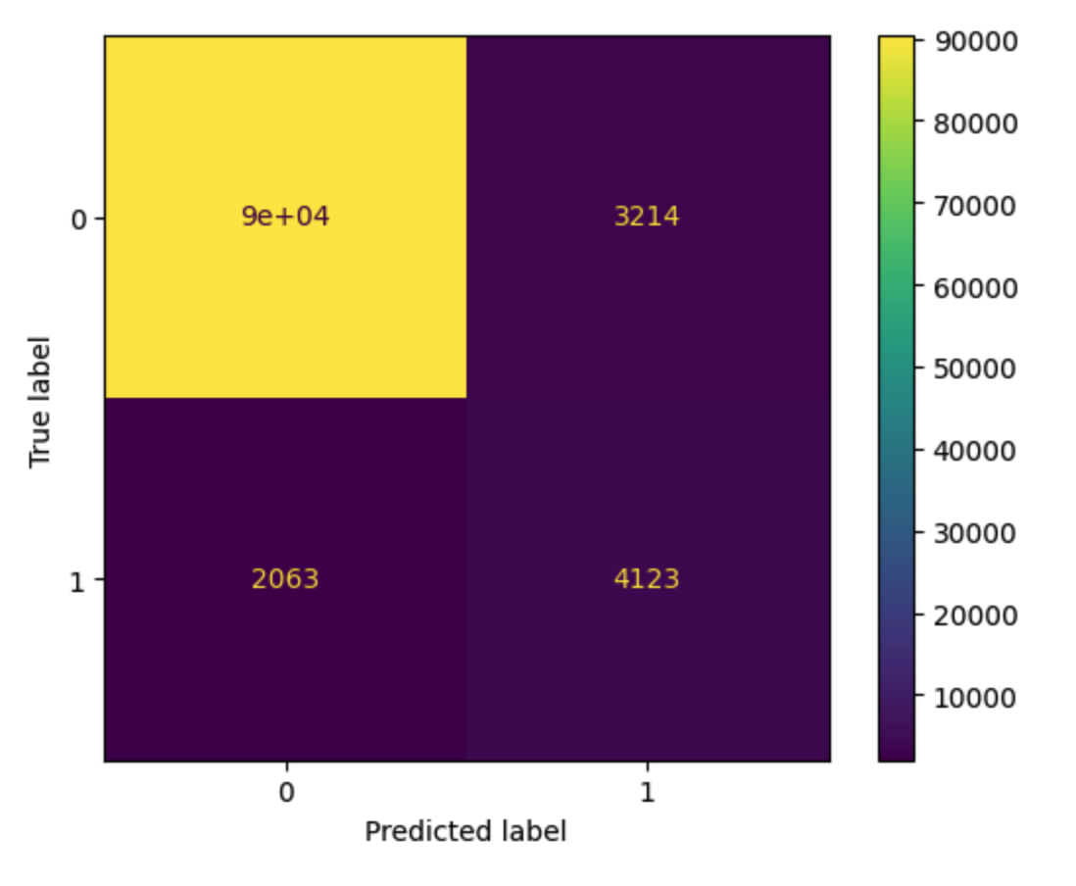
How did it perform?
We could further tune this model if we wanted to make sure that we predicted more of the >50k earners correctly at the cost of incorrectly guessing some <50k as >50k.

Slide 9
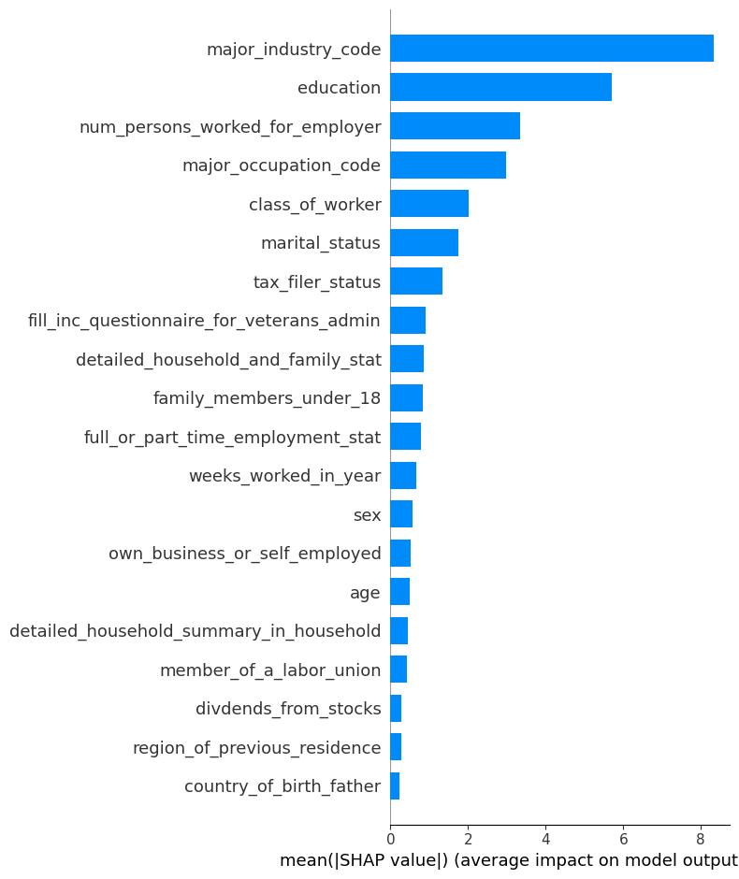
Which features were the most important?
We can use SHAP values to determine which features were the most important for our model.
These are arranged in descending order, showing that at an aggregated level Major Industry Code was the most important feature, followed by Education and the Number of Persons Worked for Employer.

Slide 10
Which features were the most important?
This sounds reasonable given that industry codes include typically highly paid industries such as Finance, Professional Services and also industries with traditionally lower salaried workers like Social Servies.
Similarly a highly educated person is likely to earn more than someone who is less educated.

Slide 11
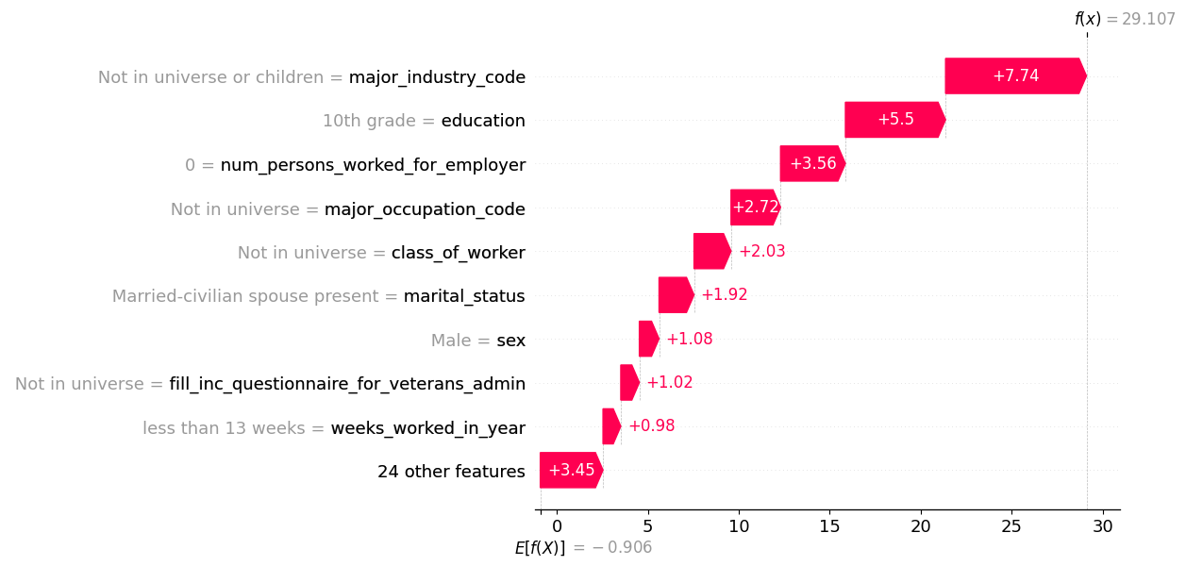
Feature importance in individual predictions
We can also use SHAP values to understand the importance of features in particular predictions.

Slide 12
Next Steps
Further time should be taken to understand the goals of the model and the business use case - are we using the right metrics? Is there any domain knowledge that would help us?
Additional feature engineering could be carried out
The model should be tuned further
The model should be put into production if there is a need. This could involve creating an API endpoint for the model to be called and passed data to have predictions generated

